Slide 1
DENIAL OF SERVICE USING MYSQL RELATIONAL DATABASE STRUCTURE BASED ON NETWORK SECURITY
Prepared By: Guided By:
Mansi singh Zakir hussain

Slide 2
Table Of The Content:
What is Dos ?
Types of Dos Attack.
Common Techniques Of Attack.
Protection Against Dos.
Project

Slide 3
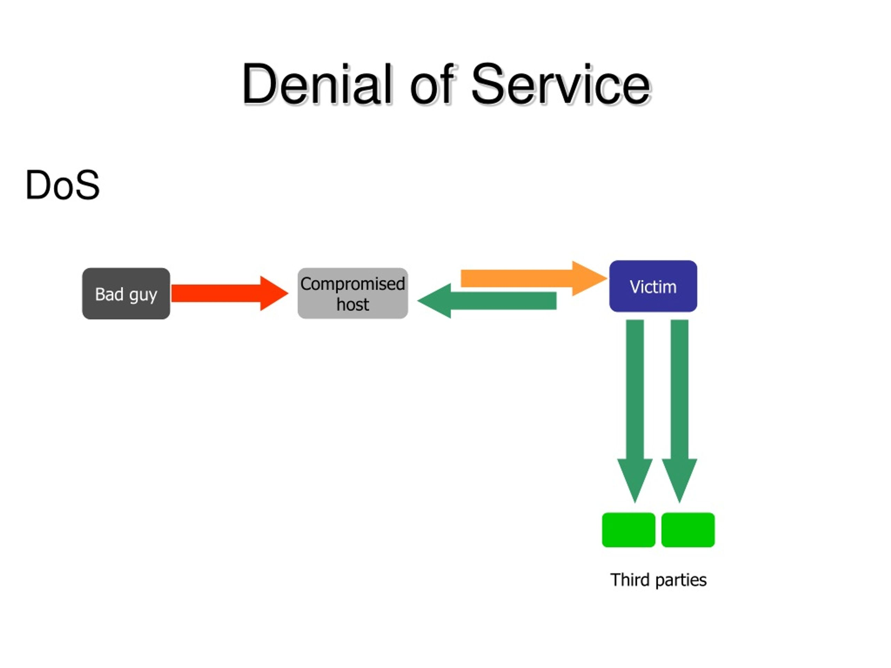
What is DoS?
A Denial-of-Service (DoS) attack is a malicious attempt to disrupt the normal functioning of a targeted server, service, or network by overwhelming it with a flood of traffic or exploiting vulnerabilities. The goal is to make the system unavailable to legitimate users, which can lead to downtime, financial loss, and damage to reputation. The goal of a DoS attack is to exhaust the resource's capacity, making it unable to handle legitimate requests.

Slide 4
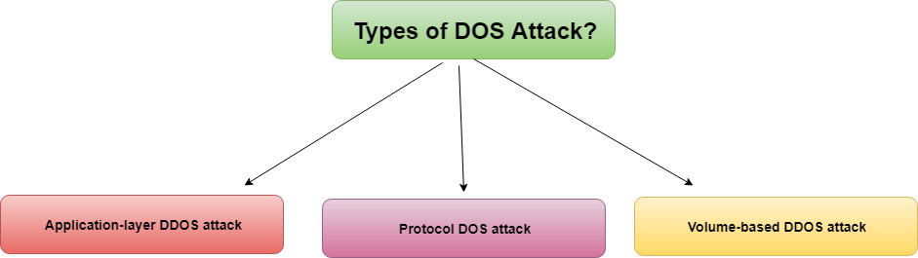
Types of DoS Attacks:
UDP Flood: Overwhelms the target with UDP packets.
.
.
.
1.Flood Attack:
UDP Flood: Overwhelms the target with UDP packets.
TCP SYN Flood: Exploits the TCP handshake by sending a flood of SYN requests without completing the handshake.
2. Application Layer Attacks:
HTTP Flood: Targets web servers with a large number of HTTP requests.
3. Resource Exhaustion:
HTTP/2 Resource Exhaustion: Takes advantage of the multiplexing feature in HTTP/2 to exhaust server resources.

Slide 5
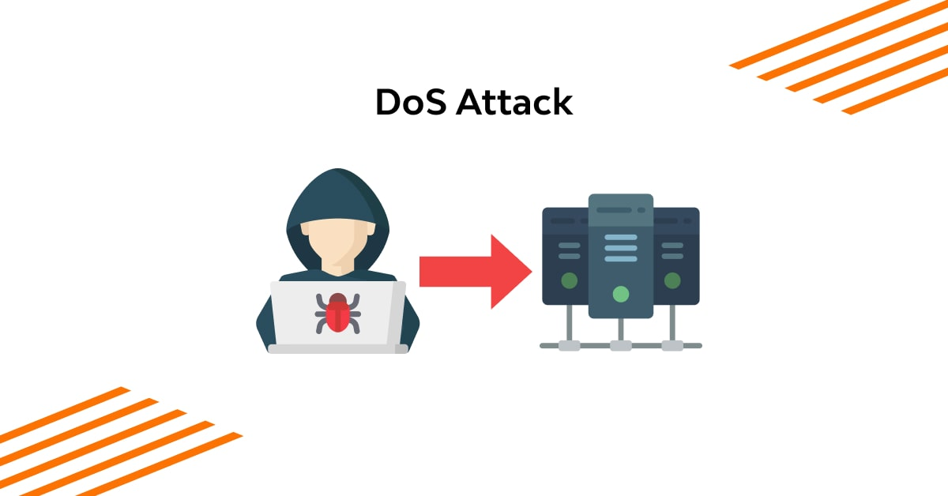
Common Attack Techniques:
1.Phishing: Deceptive emails or messages that trick users into providing sensitive information or downloading malware.
2.Malware: Malicious software such as viruses, worms, trojans, ransomware, and spyware designed to damage or exploit systems.
3.Flooding: Sending a large number of requests or traffic to overwhelm the resource. This is like trying to drink from a firehose, where the sheer volume of water is too much for the system to handle.

Slide 6
Protection Against Dos:
Distribute incoming traffic across multiple servers to mitigate the impact of an attack on any single server.
1. Network Security Measures
Firewall: Configure firewalls to filter incoming traffic and block known malicious IP addresses.
2. Traffic Management
Traffic Filtering: Use rules to allow only legitimate traffic through while blocking unwanted traffic patterns.
3. Redundancy and Load Balancing
Load Balancer: Distribute incoming traffic across multiple servers to mitigate the impact of an attack on any single server.
Content Delivery Networks(CDN):Use CDNs to cache content and absorb attack traffic, improving resilience.

Slide 7
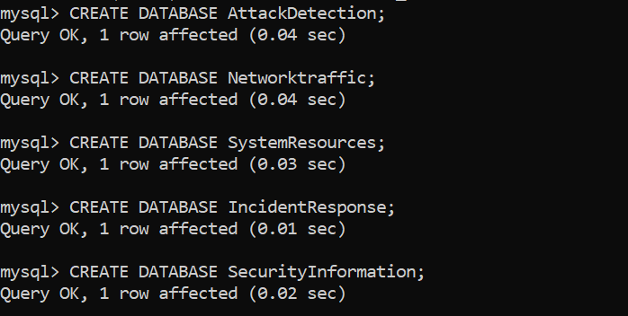
PROJECT
This project comprises five distinct databases, each containing five key tables, designed to effectively detect, monitor, and respond to Denial-of-Service (DoS) attacks.
1. Attack_Detection Database: To identify and document DoS attacks as they occur, enabling real-time awareness and response. Tables: Attacks, Attack_type, Sources, Detection_rule, alerts.
2. Network Traffic Database: To monitor and analyze network activity, facilitating the detection of abnormal traffic patterns indicative of potential tasks.Tables: traffic, protocols,ip_addresses,network_devices, traffic_stats.
3.System Resources Database: To monitor system resource utilization under attack, ensuring stability and performance are maintained. Tables:resource_usage,resources,system_stats,process_list,user_sessions.

Slide 8
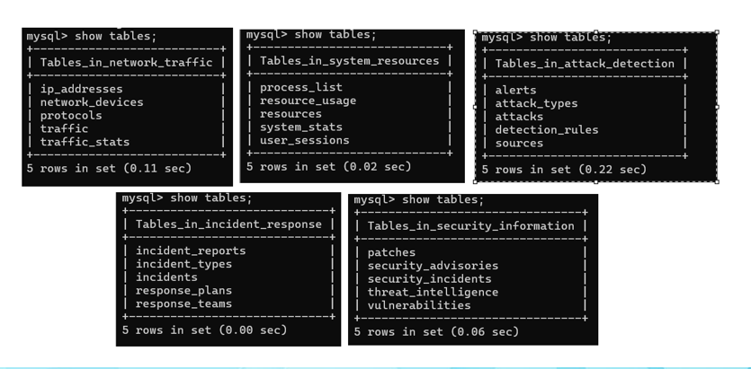
threats, enhancing overall security posture.
4. Incident Response Database: To manage and document responses to DoS incidents, ensuring effective resolution and analysis.Tables: incident,incident_types,response_plans,response_teams,incident_reports
5. Security Information Database: To track and manage information related to vulnerabilities, patches, and emerging threats, enhancing overall security posture.Tables: vulnerabilities, patches,security_advisories,threat_intelligence,security_incidents.

Slide 9
Conclusion:
This project's main goal is to create a flexible, secure, and robust system capable of identify, track, and lessen cyberattacks—especially Denial-of-service attacks. Through leveraging dynamic detection criteria, real-time alerts, and advanced analytics, the system will enhance cybersecurity overall and protect vital assets from constantly changing threats.

Slide 10


